Slide 1
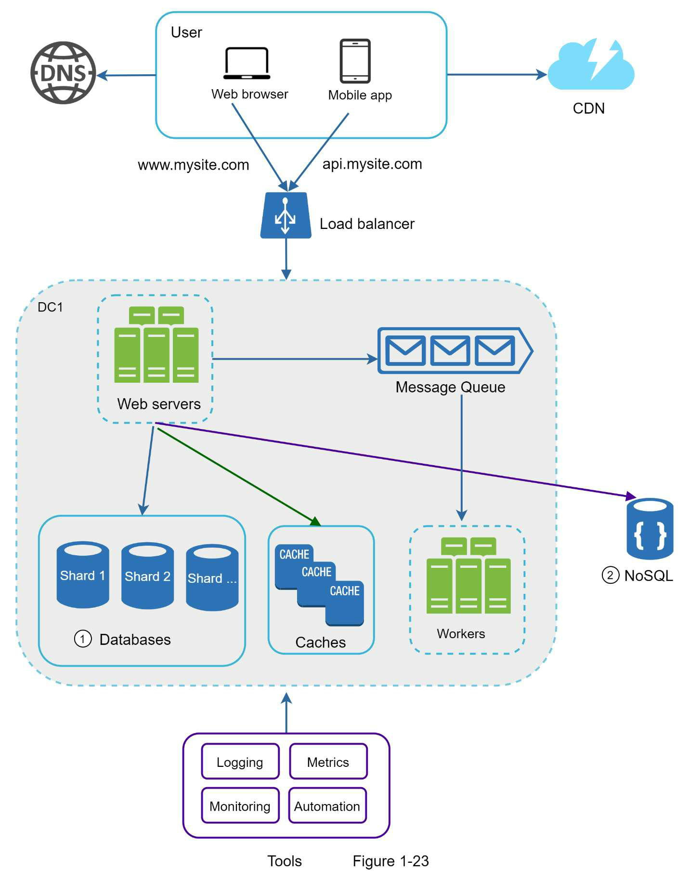
Scaling to Millions of Users
Domain name service –
converts api.mysite.com into IP address
Content delivery network (CDN): geographically dispersed servers to deliver static content
Images, videos, CSS, JavaScript files, etc.
WEB APP
Server-side langs (Java, Python) for backend, storage, business logic + client-side langs (HTML and JavaScript) for presentation
MOBILE APP
HTTP for communication, JSON – API response format for data transfer
DC2
Users are geo-(DNS)-routed to closest data center (DC)
Autoscale
Prescribe tasks to workers: crop resize, etc.
Decoupling more components for independent scaling
High availability, no single point of failure
Client / session data to make web servers stateless
DB replication and sharding
Freq. used data in memory
Doing tasks prescribed in messages
Identifying errors
Business insights, system health
Example: CI/CD

